Slide 1
Defensive Programming
Erik Poole
CS 6015

Slide 2
What is Defensive Programming?
Making small unexpected cases and errors noticeable during development
Handling unexpected cases and errors that were missed in development in a graceful way after deployment
Taking special care with sections of your code that works with code that someone else wrote.

Slide 3

Breaking Down a Program
It’s easiest for users (and programmers) to think of completed programs as one big bundle of complied code - it’s even true!
During developement though, the reality is messier…

Slide 4

Breaking Down a Program
During design, developers pull in smaller pieces of code that not only have they not written, odds are they don’t have a deep understanding of.
Most of the time this is by design! It doesn’t usually make sense for a programmer to dig to the deepest level of code they’re incorporating.

Slide 5

Why does this matter?
Sometimes the blocks don’t fit!
Sometimes this is obvious and easy to fix.
Sometimes it’s hard to see the blocks don’t match and it can cause huge problems later in production or after release.

Slide 6
Why does this matter?
Sometimes the developer expects information to be transferred between their program and the block they’ve brought in a different way than was designed.
This gets MUCH more difficult when future product users get their hands on the software as well.
3 ≠ “Three”

Slide 7
Solution: Defensive Programming!
Handle two kinds of errors at two different times -
  Errors that arise because of mismatches or bad assumptions in the code itself
  Errors that arise from unexpected user input.
(Development)
(Production)

Slide 8
Errors in Development
Sometimes finding errors is easy because the program crashes for us (we expected a Lego block and got a banana…)
Other times finding an error can be tough and can go silent for a long time before something breaks down the line (we expected a value of 1 and we got a value of 2…)
To make the second case “louder” developers can use assertions.

Slide 9
Assertions
Assertions will crash if certain conditions aren’t met and can help developers to track down unexpected bugs quickly.
A common use is to end a long, complicated routine with an assertion to make sure you’re getting a reasonable answer
  A circle’s diameter should be it’s circumference multiplied by pi
  A person’s age should be a positive value
  Etc.
Assertions should be used during development to catch conditions that the developer believes will NEVER arise.
  When they do, it means that a mistake has been made…

Slide 10
Errors during Production
Most programs rely on some user input.
It doesn’t make sense to use assertions to handle invalid user input (we don’t usually want the whole program to crash…)
Usually we want to take the invalid input in stride and handle it before continuing to perform

Slide 11
Error Handling
Robustness versus Correctness
How bad is it if we’re a little bit wrong?
Possible Handling:
  Return a neutral value (like 0)
  Duplicate the last input
  Substitute the closest legal value
  Return an error code

Slide 12
Missed Cases
Different software needs to handle errors differently!
  Typing an invalid character in Microsoft Word
  vs
  Invalid measurements in a remote surgical instrument
One of those we probably would rather just live with the bug and proceed as usual, one of those we definitely want to crash!!!

Slide 13
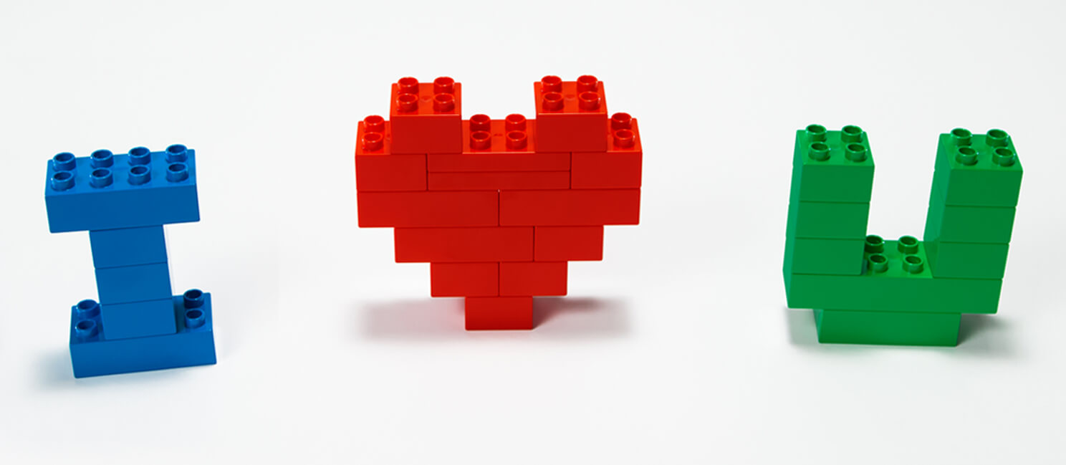
Defensive Programming

